Slide 1

King County House Sales
Review and explore the sold house prices in King County in 2014-2015

Slide 2
Introduction:
Recently, by growing technology companies in WA, buying a house is one of the most challenging tasks for people. In this project, I’ve used the data from Kaggle. There are over 21,000 records with 21 columns. I am evaluating these columns to create a model for predicting future prices.

Slide 3
Problem Statement:
Review and find the most influential factors on home sales.
Investigate the distribution of sold homes in 2014 and 2015
Check sales prices in different areas of King County.
Create a model to predict the house price.

Slide 4
Methodology :
I’ve used the OSEMiN data science workflow, which involves:
Obtain (import the data)
Scrub (clean the data, deal with missing values and data types)
Explore (answer descriptive questions using EDA)
Model (model selection)
Interpret (comment on our model and findings)

Slide 5
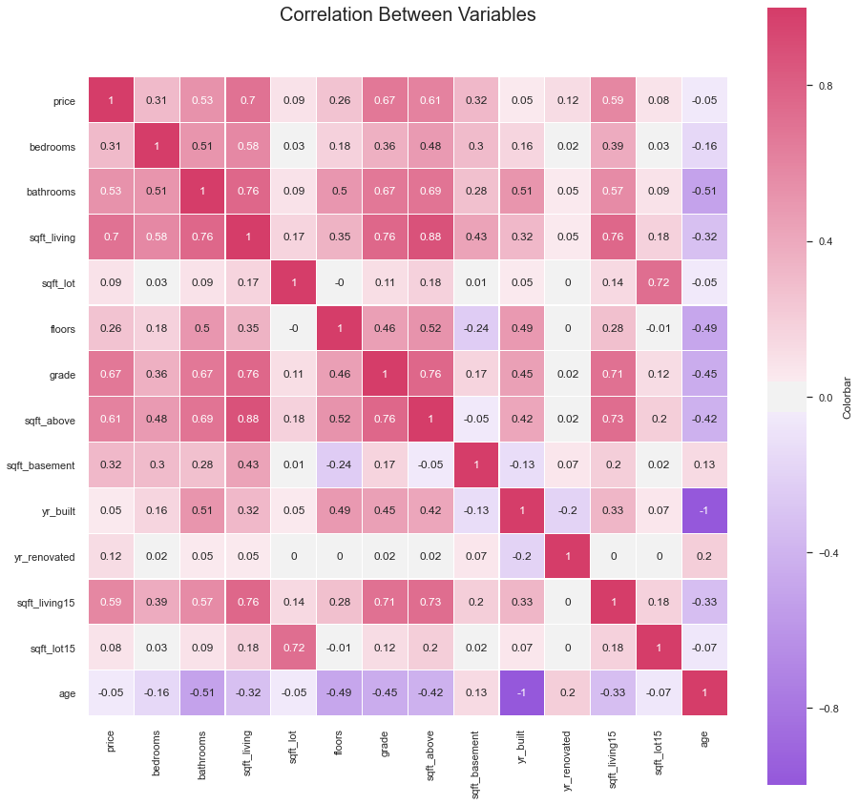
Correlation Between variables:
There is a positive strong linear relationship between price and square footage living area, grade, square footage of house apart from basement, and average square footage of living area.

Slide 6
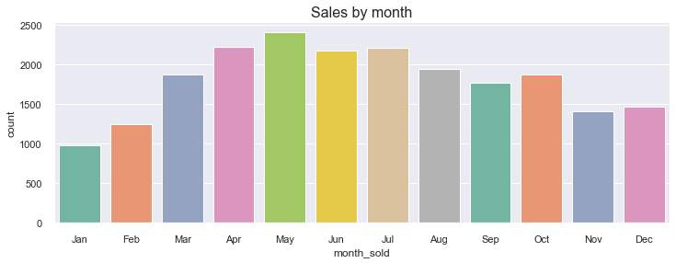
Best Time For Buying or Selling the House:

Slide 7
King County Average Price:

Slide 8
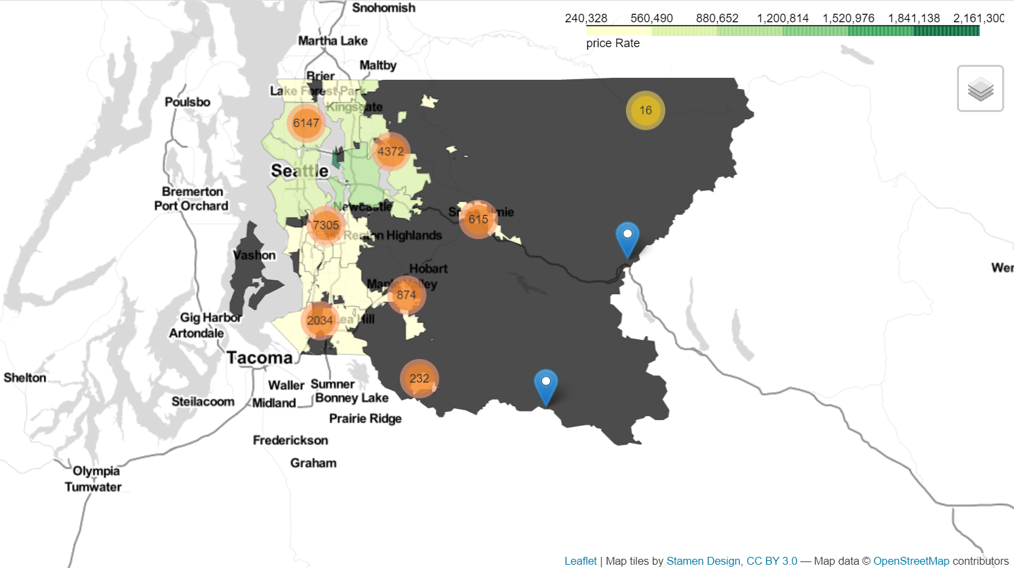
King County House Density:

Slide 9
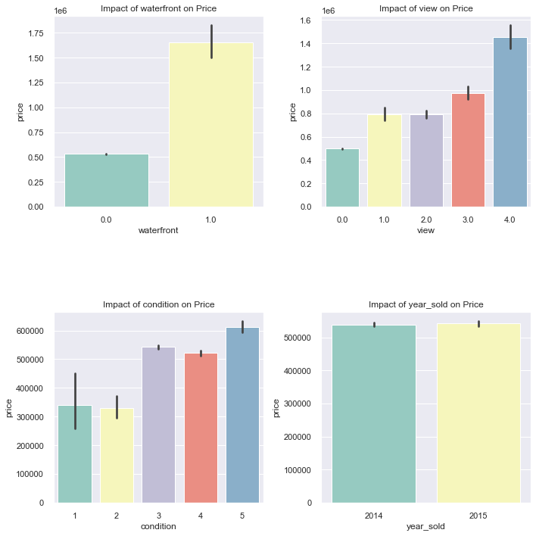
Impact of waterfront, view, condition and sold year on price:
Based on the charts, view and waterfront have impact on the price.
By increasing the house price the condition gets better.
Sold year, passing the time can affect on price.

Slide 10
Conclusion:
The location and the city have a significant role in house prices.
The sold houses in the northern and southern area were cheaper than in eastern and Seattle.
The largest number of sold houses were in Seattle.
The month of buying a house have an significant role in the price of a house.
The best time to buy a home is from the beginning of September to the end of January.

Slide 11
Future Work:
There are other factors that can affect the price of a home. These factors include the impact of inflation, commute, school, job opportunities in the area, and more. Examining each of these factors can play an important role in predicting house prices.

Slide 12
Thank You!

